Slide 1
Research and Clinical Applications of TMS in Pediatric and Neurodevelopmental Populations
Lindsay M. Oberman, PhD
Clinical TMS Society Grand Rounds
March 5, 2024

Slide 2
Disclosures
The views expressed in this presentation do not necessarily represent the views of the National Institutes of Health, the Department of Health and Human Services, or the United States Government.

Slide 3
Learning Objectives
Review the findings of studies using TMS to probe physiology in autism spectrum disorder (ASD).
Describe how TMS can be used to induce long-term changes in brain network functioning and potentially treat pediatric neuropsychiatric and behavioral disorders.
Identify potential network targets where applying TMS may be effective for reducing transdiagnostic symptom domains commonly seen in neuropsychiatric and behavioral disorders.

Slide 4
Clinical Motivation for Research Focus
The CDC currently estimates that nearly 1 in 5 children have a developmental or psychiatric disorder
Evidence-based, brain network-targeted treatments for these disorders are limited.
No rTMS protocols have been FDA cleared for pediatric use.
ECT only cleared for adolescents and adults age 13 or older and state restrictions limit access to individuals under 18.

Slide 5
Research Motivation for Research Focus
Most rTMS clinical trials that enroll pediatric patients are:
Underpowered
Do not optimize dose in space, time, or context
Utilize adult parameters, ignoring neurodevelopment
Not designed to optimize effect size (large placebo effect, underdosed, or unknown target engagement)
Negative (one large ASD trial and one large adolescent depression trial)

Slide 6
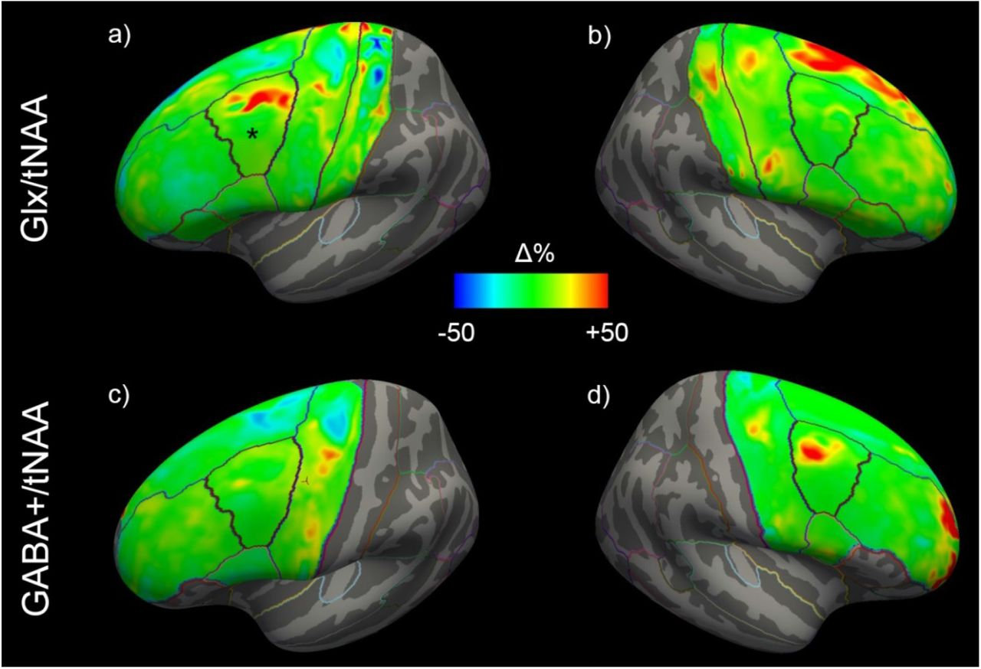
rTMS, What we think we know…
rTMS can lead to both acute and long-term modulation of neurochemicals implicated in the pathophysiology of ASD and adolescent mood disorders (e.g. GABA and Glutamate)
Gröhn et al., 2019
Spurny-Dworak et al., 2022
Stagg et al., 2009

Slide 7
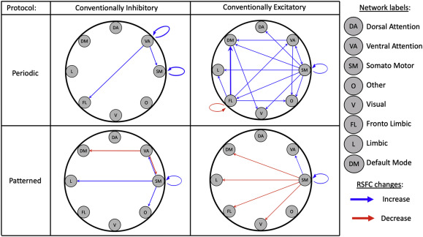
rTMS, What we think we know…
rTMS can lead to both acute and long-term modulation of functional network connectivity in circuits implicated in the pathophysiology of ASD and adolescent mood disorders
Beynel et al., 2020

Slide 8
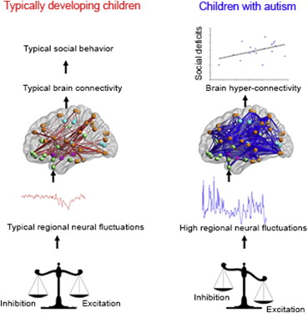
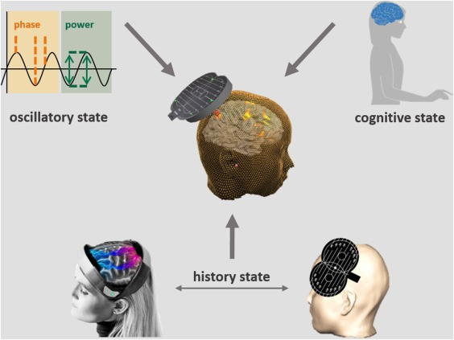
rTMS, What we think we know…
Both direction and degree of rTMS modulation is influenced by brain state.
ASD and adolescent mood disorders may have different baseline levels of neurochemicals (e.g. GABA and Glutamate) and altered functional connectivity
Caveat: Most of what we think we know is based on studies in typically developing adults and adults with TR-MDD.
We can not assume that the response to rTMS protocols will be the same in these pediatric populations
Supekar et al., 2013

Slide 9
Children/Adolescents are not just Small Adults
Across Development…
Cortical Regions are growing, shrinking, and shaping at variable speeds.
Neurochemicals are fluxuating
Myelination is occurring

Slide 10
Brain Charts for Human Lifespan, 2022

Slide 11
Brain Charts for Human Lifespan, 2022

Slide 12
Children/Adolescents are not just Small Adults
Across Development…
Cortical Regions are growing, shrinking, and shaping at variable speeds.
Neurochemicals are fluxuating
Myelination is occurring
Functional networks are forming and being modified by developmental and experience-dependent plasticity

Slide 13
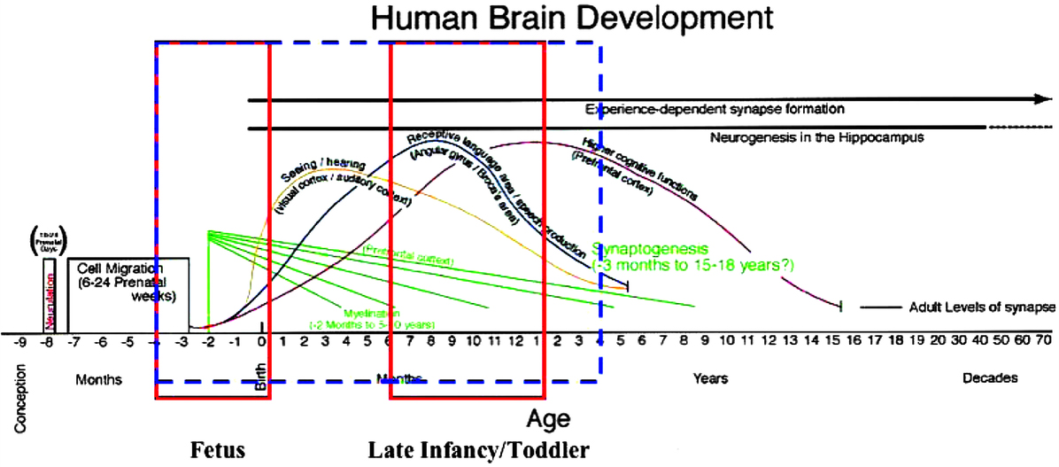
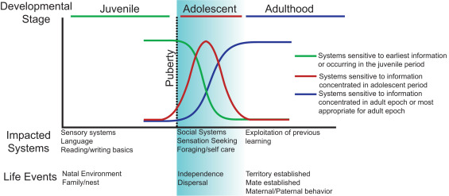
Differential Development by System/Network across the age span
Georgieff and Innis, 2005
Piekarski et al., 2017

Slide 14
Children/Adolescents are not just Small Adults
Across Development…
Cortical Regions are growing, shrinking, and shaping at variable speeds.
Neurochemicals are fluxuating
Myelination is occurring
Functional networks are forming and being modified by developmental and experience-dependent plasticity
Neurodevelopmental and Pediatric Neuropsychiatric Disorders may be impacting these states.

Slide 15
Brain Charts for Human Lifespan, 2022

Slide 16
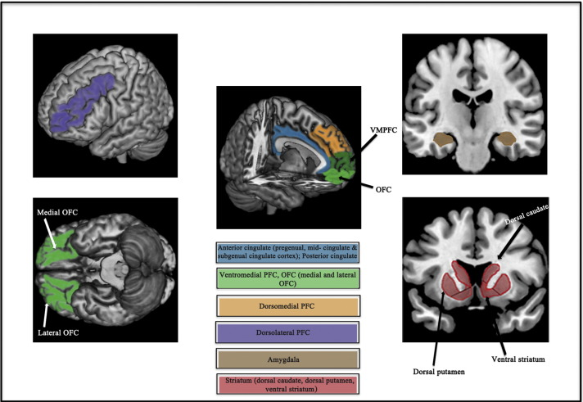
Functional Regions/Networks implicated in Adolescent MDD
Kerestes et al., 2014 – Meta-analysis of Resting-state and Task-related (Emotional processing, cognitive control, affective cognition and reward-based decision-making) Activity/Connectivity from fMRI data in depressed youth
Similar Functional Networks Implicated between Adult and Adolescent MDD
Implicated similar to regions used as biological targets for clinical interventions in adult patients (including DBS and CBT).
Above areas associated with clinical measures of depression severity, duration of illness, rumination scores, and cognitive vulnerability in adolescents
Activity in the subgenual ACC and amygdala appears to be responsive to antidepressant treatment in depressed adolescents (Tao et al., 2012).

Slide 17
Differences between pediatric versus Adult Clinical Presentations

Slide 18
Complexity
“The brain is a monstrous, beautiful mess.”
- Susannah Calahan

Slide 19
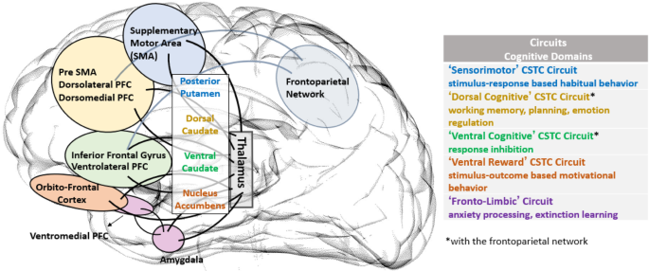
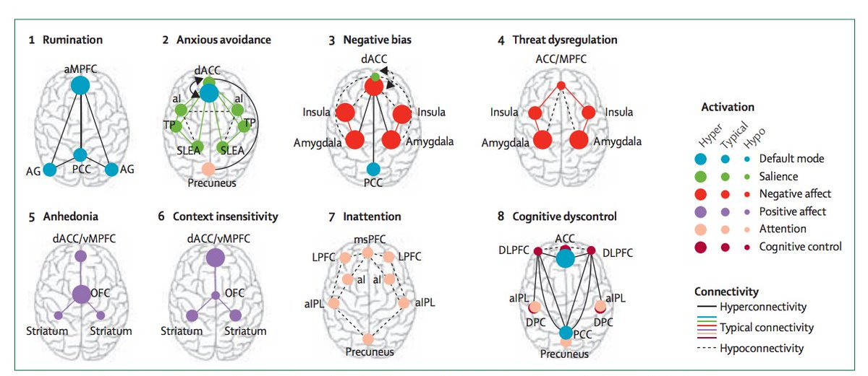
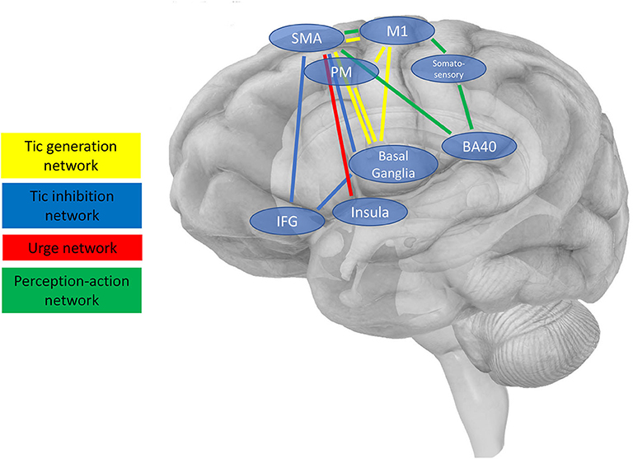
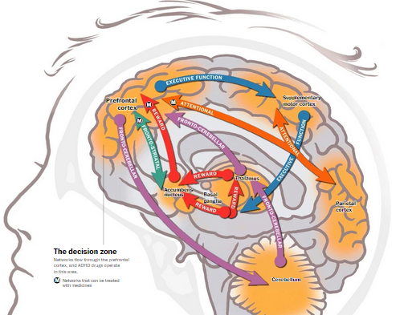
Heterogeneity in Brain Network Dysfunction in Neurodevelopmental and Neuropsychiatric Disorders
ASD
OCD
Simpson et al., 2020
Müller and Fishman, 2018
Anxiety and Depression
Tourette Syndrome
ADHD
Kleimaker et al., 2020
Holiner Psychiatric Group
Williams, 2016

Slide 20
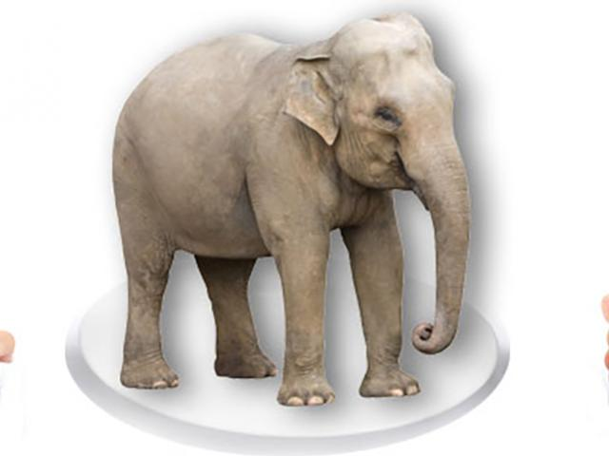
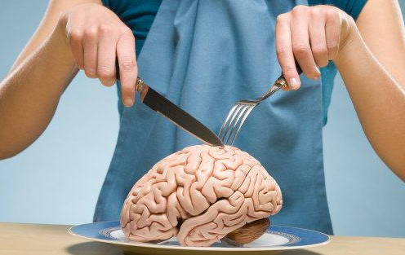
How do you Eat an Elephant?
One Bite (or TMS pulse) at a time!

Slide 21
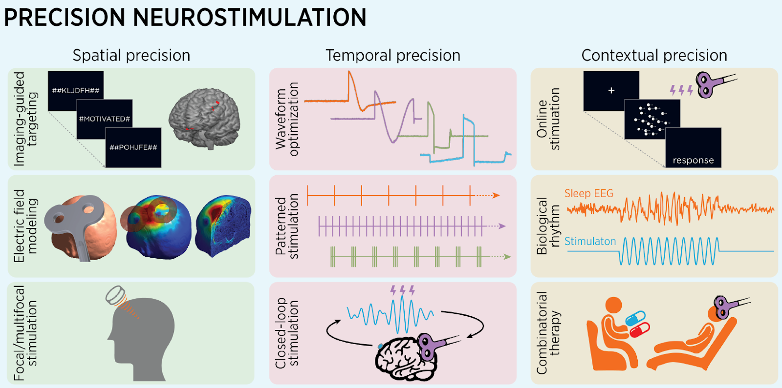
Efficacy of TMS = Parameters + Individual Brain Factors
Deng et al., 2020

Slide 22
TMS Parameters and Effect on “Dose” for the Pediatric Brain
Parameter | Impact of Age/Development
Intensity | More isn’t necessarily better (Even in Adults). Younger Children may need higher intensities due to lack of myelination, however, older children/adolescents may need the same or perhaps lower intensities based on neurochemical changes. Clinical Disorders may impact cortical excitability and neurochemical levels and thus may impact appropriate intensity
Frequency/Protocol | 1 Hz is generally locally inhibitory across the age-span. 10-20 Hz is generally locally excitatory across the age-span. cTBS and iTBS have high inter-individual variability. Overall impact on networks may depend on stage of development.
Intertrain Interval | Needs to be short enough to allow for additive effects, Children/Those with clinical disorders may have different timelines for metaplasticity.
Number of Sessions | More sessions have been found to be the best predictor of efficacy in adults. Likely the case in youth.
Intersession Interval | Needs to be short enough to allow for additive effects, but needs to be long enough to allow for homeostatic mechanisms. Children/Those with clinical disorders may have different timelines for metaplasticity.
Target/Targeting Strategy | Depends on what behavior/symptom you are trying to target. The specificity/reliability of your target is only as good as your certainty that this is the “right” target for that individual. Networks are in flux during development and impacted by clinical disorders, so need to understand both to know where and how best to target.

Slide 23
Using TMS to Study the Pathophysiology of ASD

Slide 24
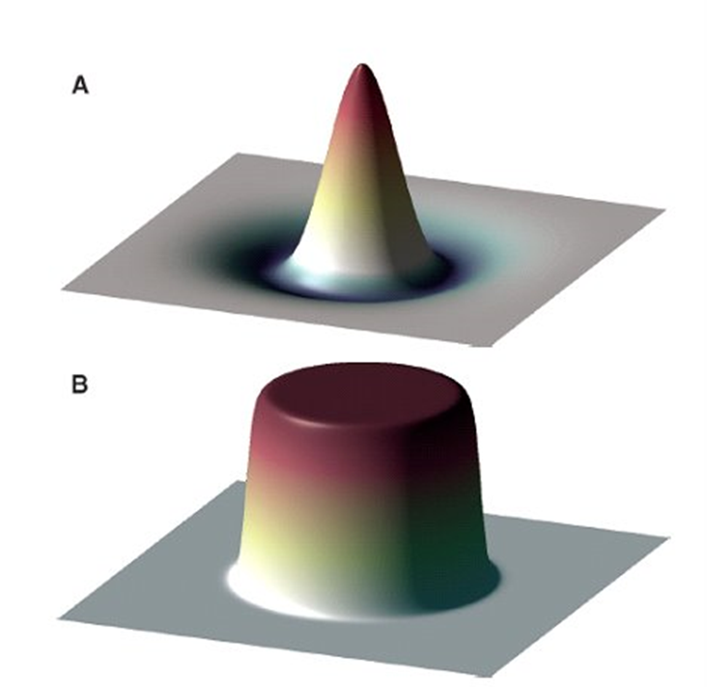
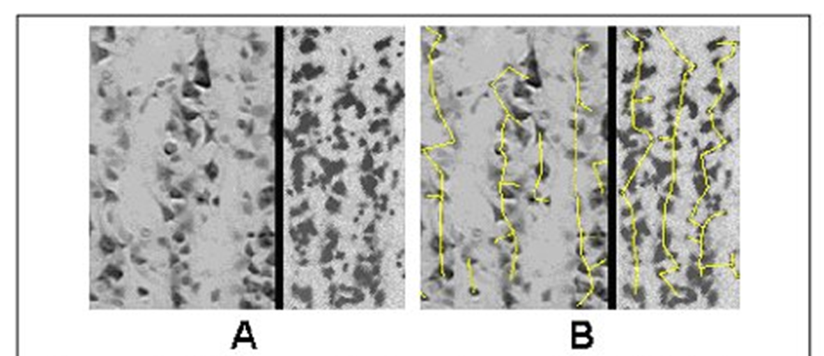
GABA deficiency Hypothesis in ASD
Casanova et al., 2002; Casanova et al., 2006

Slide 25
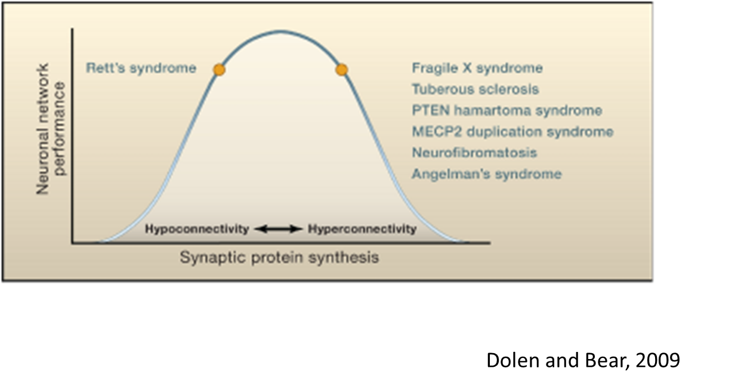
Excessive Glutamate Hypothesis

Slide 26
Proposed Pathophysiological Model of ASD
Predictor Variables
Aberrant Network Structural Connectivity
Dependent Variable
Predictor Variables
Development
Aberrant Physiological and Behavioral Response to Stimuli in the Environment
E/I Imbalance
Aberrant Network Functional Connectivity
Development

Slide 27
Prolonged and Enhanced Response to TBS protocols in ASD
MEP amplitude
[proportion of baseline]
ITBS
Baseline
CTBS
Time after TBS [min]
Oberman et al., 2012
Oberman et al., 2012

Slide 28
Aberrant Metaplastic Response to two sessions of TBS on subsequent days in ASD
Oberman et al., 2016

Slide 29
Developmental (Cross sectional) Trajectories
Oberman et al., 2014

Slide 30
Interim Conclusions on Use of TMS in ASD based on Neurophysiology Studies
Greater and Longer lasting response to cTBS in ASD with maximum group difference at 40 minutes post cTBS in adults.
Abnormal “Metaplasticity” affecting response to a subsequent stimulation 24 hours later.
Response may increase with age in ASD group, but quite variable and limited normative data.
Data collected from the motor cortex, can we translate to regions relevant to clinical symptoms?

Slide 31
Relationship of these Aberrant Mechanisms to Clinical Symptoms: Language Processing in ASD

Slide 32
Specific Aim 1 for ongoing NIMH IRP Study on Language Processing in ASD
Specific Aim 1: Establish the relationship between baseline local Neurochemical concentration (in left pSTC “Wernicke’s Area”), structural and functional network connectivity (within the dorsal and ventral language networks) and MEG indices of auditory and language processing (Specific Aim 1).
Predictor Variables
Predictor Variables
Aberrant Network Structural Connectivity (DTI)
Dependent Variable
E/I Imbalance (MRS)
Development
Aberrant (Task-based) Physiological Response (MEG)
Aberrant Network Functional Connectivity (Resting State and Task-Related fMRI)
Development

Slide 33
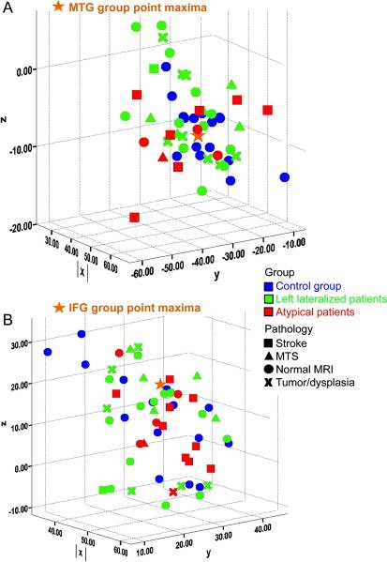
Language Processing in ASD Study: Specific Aim 1 Procedures
Resting-state and Task-related (ADDT) fMRI for individualized targeting
Neuropsych. Testing
Audiometry

Slide 34
Language Processing in ASD Study: Specific Aim 2
Specific Aim 2: Assess the degree to which a single session of continuous theta burst stimulation (cTBS) over left pSTC affects local Neurochemical concentration, network functional connectivity, and MEG indices of auditory and language processing (Specific Aim 2).

Slide 35
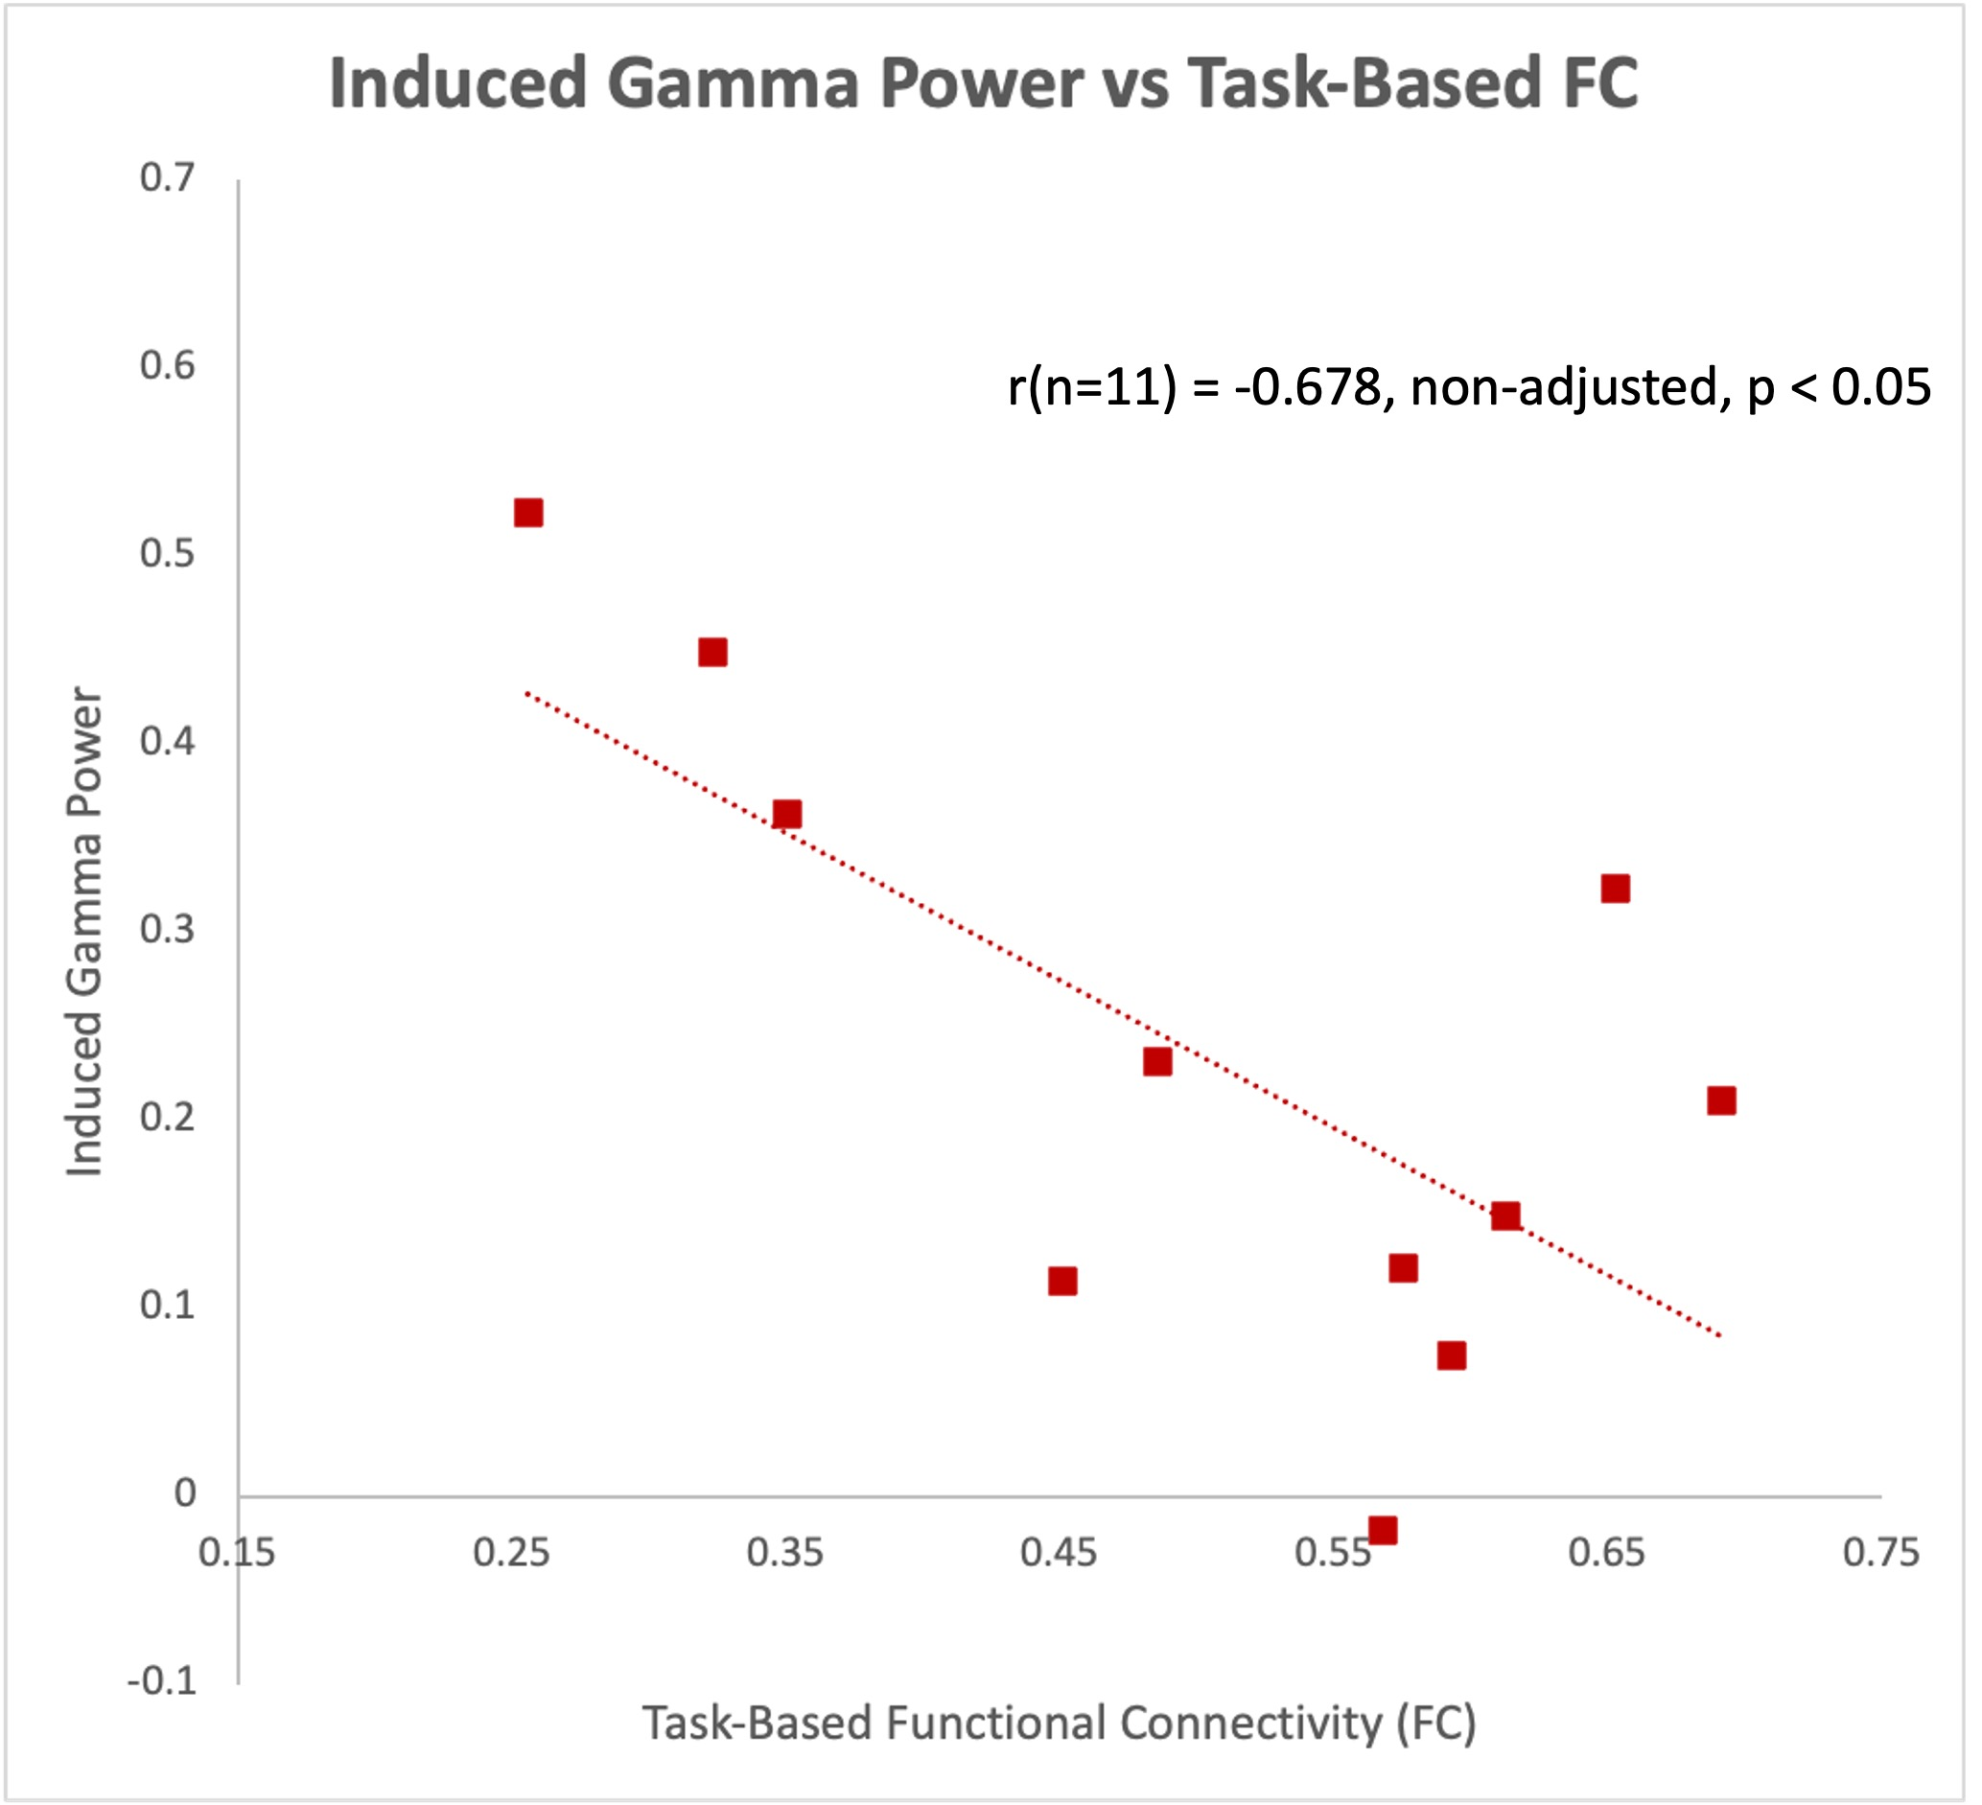
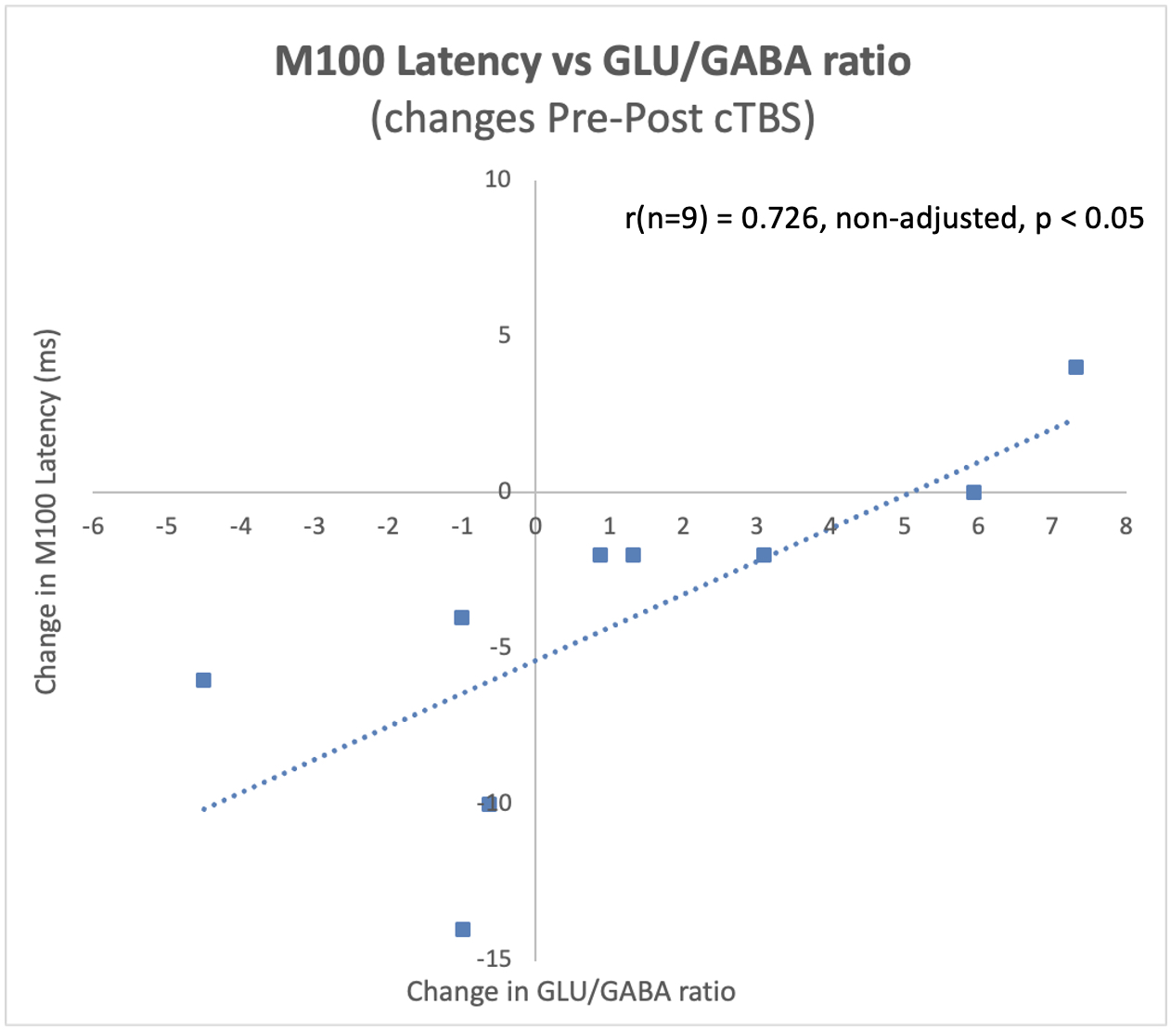
Language Processing in ASD Study: Pilot Data
Baseline Correlations
Pre-Post cTBS Correlations

Slide 36
Applying and Enhancing our Knowledge about Pathophysiology – Behavior Relationship to Improve Spatial Precision and Measure Efficacy of rTMS for Adolescent Depression

Slide 37
Existing Data on rTMS in Adolescent Depression
Oberman et al., 2020
Much less data than in Adults
20 publications representing 12 unique datasets representing approx. 280 adolescent participants with MDD
Less than 100 of which have pre/post fMRI data
Compared to Over 1,000 publications representing hundreds of unique datasets and hundreds of thousands of adult participants
Not neurodevelopmentally informed (10/12 applied 10 Hz at 120% MT to L. DLPFC)
Small Sample Sizes (7/12 had sample sizes n≤10)
Only large-scale trial (Neuronetics) was negative (5 cm, 10 Hz at 120% MT to L. DLPFC
Not Neuronavigated (only 4/12 used MRI-based neuronavigation)
Underdosed (7/12 had less than 20 sessions of treatment)

Slide 38
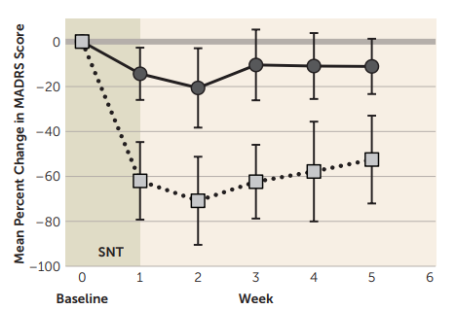
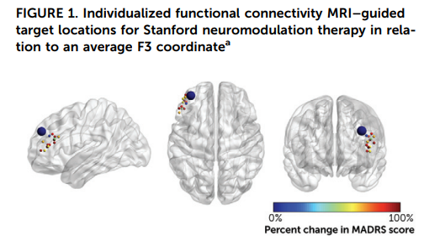
Novel Individually Targeted Accelerated TMS Protocol: SNT
Cole et al., 2022

Slide 39
Ongoing NIMH IRP Adolescent Depression Trial
Open label, FDA-IDE
Accelerated iTBS (multiple sessions/day, 2-3 week duration of treatment)
Targeting based on individualized resting state functional connectivity between DLPFC and subgenual cingulate
Optimized using E-field modelling
MRI and MRS pre/post intervention

Slide 40
How do you Eat an Elephant? One Bite at a time!
Current Status:
Conducting Secondary Retrospective Analyses to identify optimal targets across disorders and development
Language Processing in ASD study
Completed Pilot phase
Established Feasibility and Tolerability
Analyzed and Published Pilot Data supporting hypotheses
Enrolling/Collecting data for Main (ASD Phase).
Adolescent Depression Trial:
Enrolling/Collecting data
Obtaining and testing out equipment and software, establishing collaborations, and writing protocols for future Transdiagnostic studies
Emotion Dysregulation
Sensory Hyperresponsivity
Sleep Dysfunction
Catatonia

Slide 42
Collaborators
Neurodevelopmental and Behavioral Phenotyping Service
Dr. Audrey Thurm
Emotion and Development Branch
Dr. Danny Pine
Dr. Andre Zugman
Autoimmune Brain Disorders Program
Dr. Gena Mooneyham
Section on Social and Cognitive Developmental Neuroscience
Dr. Tonya White
Outside Collaborators
Dr. Tim Roberts (CHOP)
Experimental Therapeutics Branch
Dr. Carlos Zarate
Dr. Elizabeth Ballard
Dr. Jessica Gilbert
Center for Multimodal Neuroimaging
Dr. Allison Nugent
Dr. Jeff Stout
Dr. Jan Willem Vanderveen
Dr. Joelle Sarls
Dr. Francisco Pereira
Dr. Dylan Nielson

Slide 43
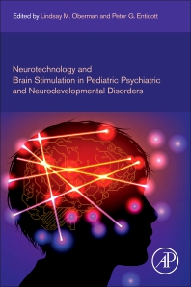
Questions? Concerns ☹ Comments
THANK YOU!
Lindsay.Oberman@nih.gov

